Slide 1

DEMAND FORECASTING ON E-COMMERCE
JASWANTHSIVAJI GODASU
19-JULY-2024

Slide 2
CONTENTS
Problem Statement
Dataset Overview
Exploratory Data Analysis
Feature Engineering
Visualisation
Time Series Analysis
Demand Forecasting Models
Comparison Of All Forecasting Models
Conclusion

Slide 3
1. Problem statement
This project aims to develop a sophisticated model using historical sales data and Google Analytics KPIs, like Google clicks and Facebook impressions.
To predict future product demand and understand customer behavior.
OUTCOMES
Develop Demand Forecasting Model
Identify Trends and Seasonal Patterns
Build Predictive Models

Slide 4
2. Dataset overview
ProductA.csv:
Contains data related to product demand, including day index and quantity sold.
Used for analyzing trends and forecasting demand.
ProductA_google_clicks.csv:
Includes daily data on Google clicks.
Helps in understanding the correlation between Online advertising and product demand.
ProductA_fb_impressions.csv:
Captures daily Facebook impressions.
Useful for examining the impact of social media advertising on product demand.

Slide 5
3. Exploratory Data Analysis
Merging the data :
Initially the data contains , Product A : (212, 4) Product A Google Clicks : (212, 4) Product A Facebook Impressions : (212, 4)
Merged the three datasets with Day Index column . Merged data : (212, 4)
Here for no data loss , we used left join.

Slide 6
Missing values imputation : There are no missing values.
Outlier detection and replacement : Identify Outliers:
Calculate Q1 (25th percentile) and Q3 (75th percentile)
Compute IQR (Interquartile Range):
IQR=Q3−Q1
Define bounds: Lower=Q1−1.5×IQR, Upper=Q3+1.5×IQR
Quantity column contains outliers.
Replaced the outliers with median value of the Quantity column.

Slide 7
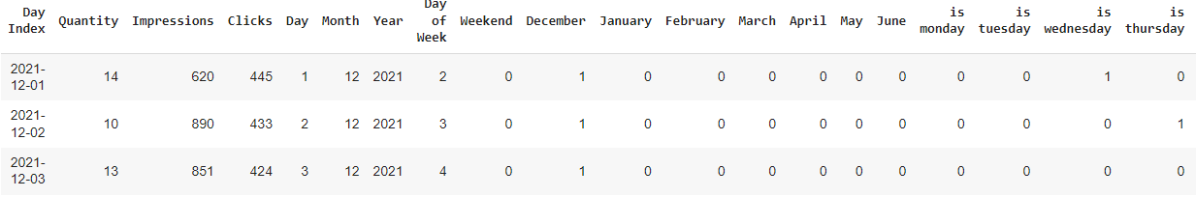
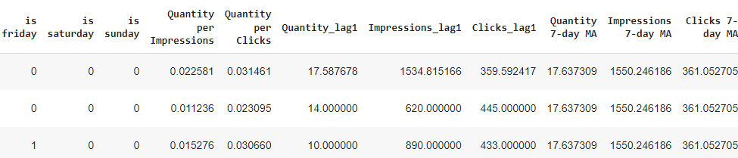
4. Feature engineering
Date-related Features
Month-specific Features
Day-specific Features
Rate Calculation Features
Lag Features
Rolling Statistics Features
Handling Missing Values

Slide 8
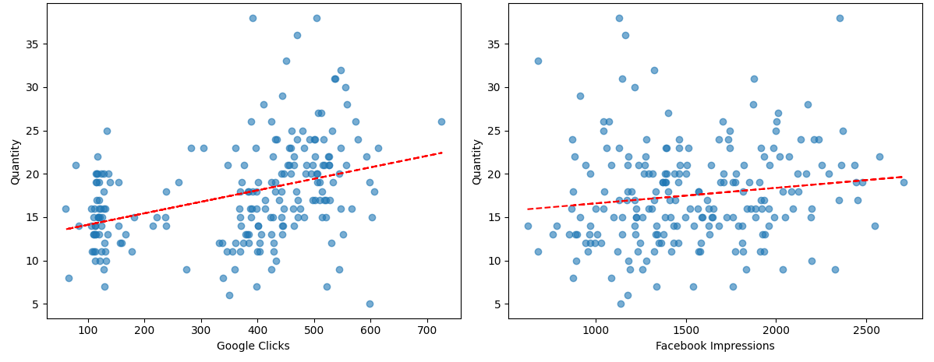
5. Visualisation
Google clicks vs Quantity Facebook Impressions vs Quantity
Here we can see that there is positive correlation between google clicks and quantity and also there is positive correlation between face book impressions and quantity.

Slide 9
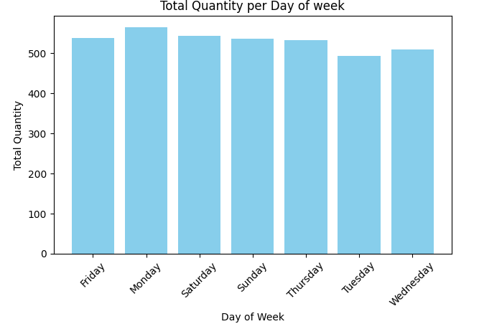
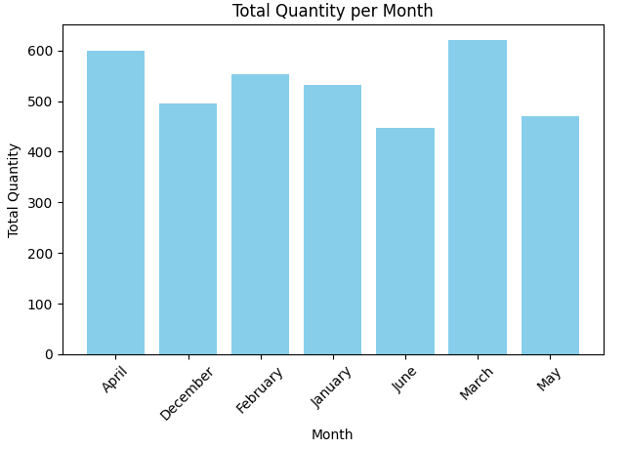
From the graph we can say that March has the highest quantity and has lowest quantity.
We can observe that Monday has highest quantity and Tuesday has lowest quantity.

Slide 10
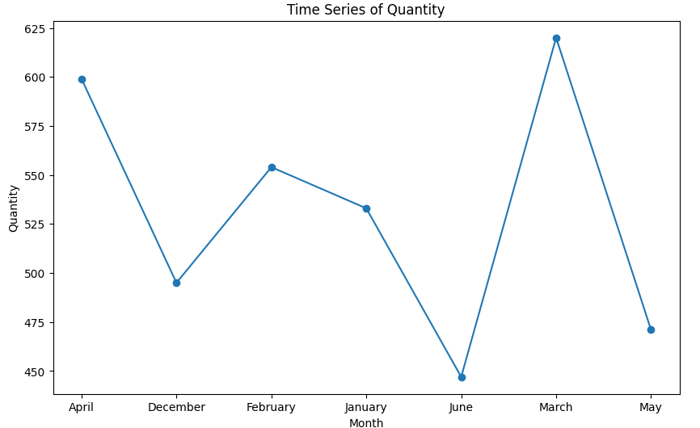
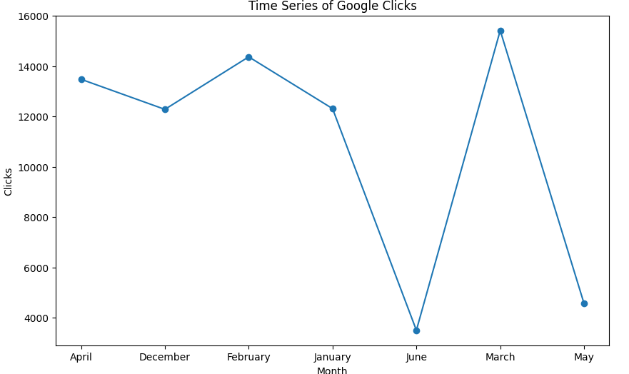
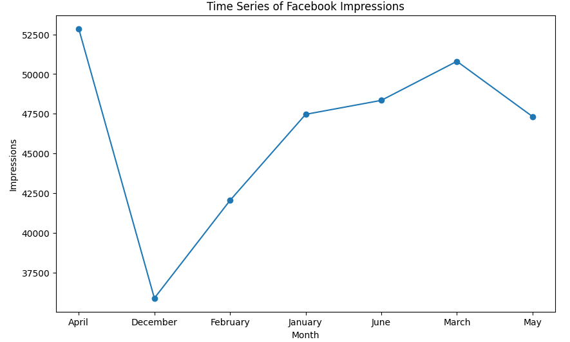
In March we have high quantity and June have low quantity.
In March we have high number of clicks and June have low number of clicks.
April has highest number of impressions and December has lowest number of impressions.

Slide 11
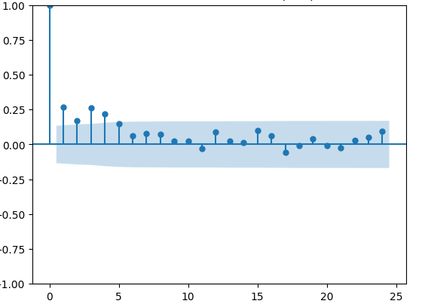
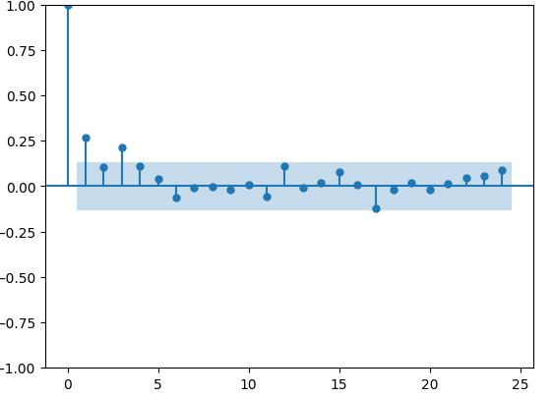
6. Time Series Analysis
Autocorrelation Function
Partial Autocorrelation Function
In the given ACF plot, significant spikes are observed at 1,2 and 3
Followed by a rapid decline . This suggests a q value around 1 or 2.
In the given PACF plot, significant spikes are observed at 1,2 and 3
Followed by a rapid decline . This suggests a q value around 1 or 2.

Slide 12
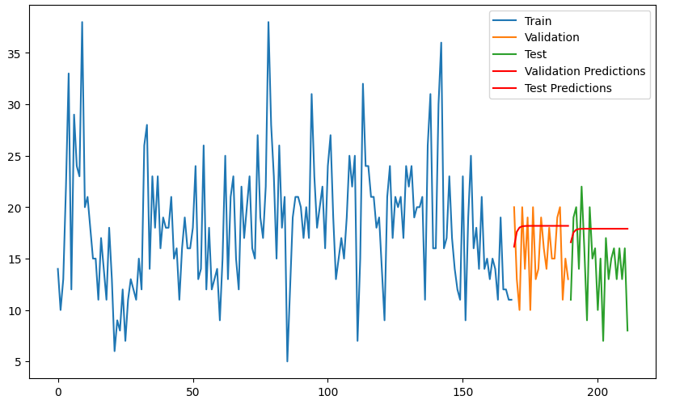
7. Demand forecasting models
AR Model
Validation Metrics:
RMSE : 4.21
MAPE : 0.27
R² : -0.61
Adjusted R²: -0.79
Test Metrics:
RMSE : 4.99
MAPE : 0.37
R² : -0.69
Adjusted R²: -0.87

Slide 13
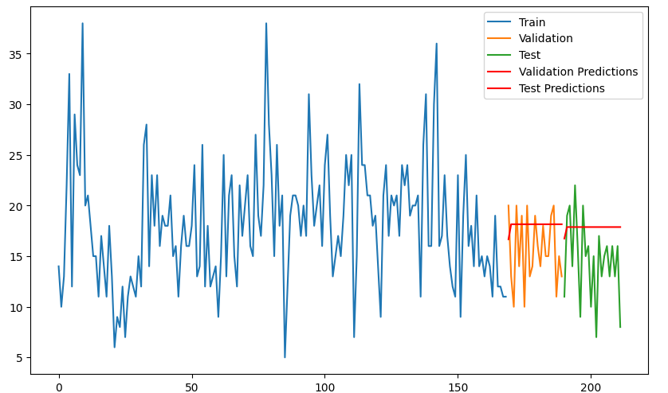
MA Model
Validation Metrics:
RMSE : 4.21
MAPE : 0.27
R² : -0.61
Adjusted R²: -0.90
Test Metrics:
RMSE : 4.98
MAPE : 0.37
R² : -0.687
Adjusted R²: -0.97

Slide 14
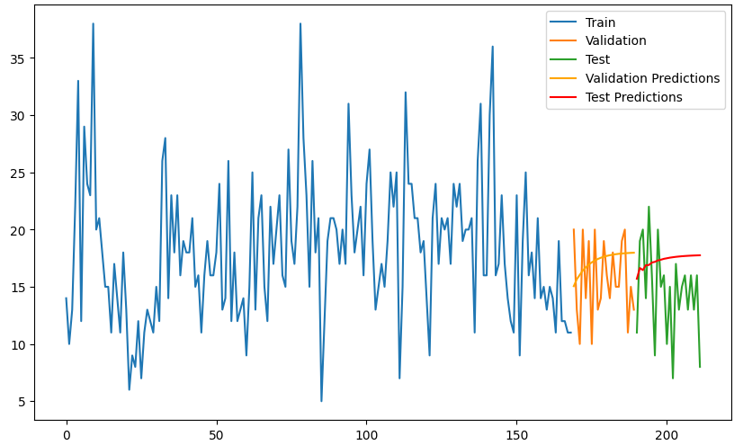
ARIMA Model
Validation Metrics:
RMSE : 3.81
MAPE : 0.24
R² : -0.32
Adjusted R²: -0.88
Test Metrics:
RMSE : 4.81
MAPE : 0.35
R² : -0.57
Adjusted R²: -1.20

Slide 15
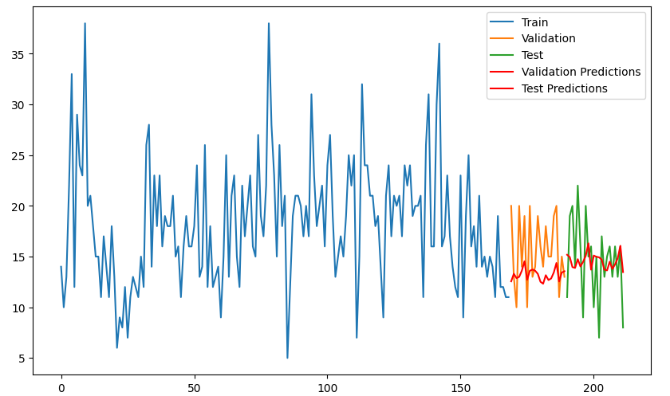
SARIMA Model
Validation Metrics:
RMSE : 3.96
MAPE : 0.19
R² : -0.43
Adjusted R²: -1.20
Test Metrics:
RMSE : 3.83
MAPE : 0.24
R² : -0.001
Adjusted R²: -0.31

Slide 16
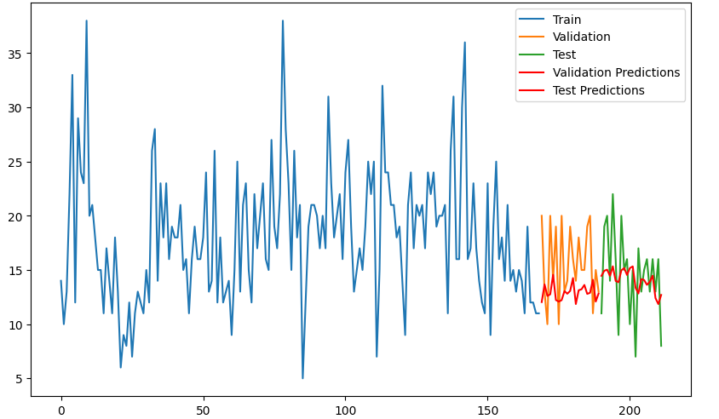
ARIMAX Model
Validation Metrics:
RMSE : 4.44
MAPE : 0.20
R² : -0.79
Adjusted R²: -4.98
Test Metrics:
RMSE : 3.62
MAPE : 0.23
R² : -0.10
Adjusted R²: -1.67

Slide 17
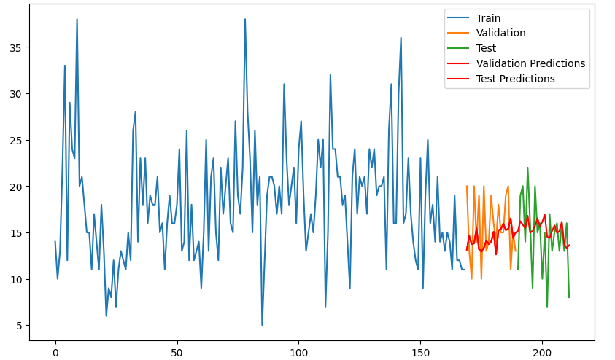
SARIMAX Model
Validation Metrics:
RMSE : 3.77
MAPE : 0.19
R² : -0.29
Adjusted R²: 3.35
Test Metrics:
RMSE : 3.68
MAPE : 0.22
R² : -0.03
Adjusted R²: 3.17

Slide 18
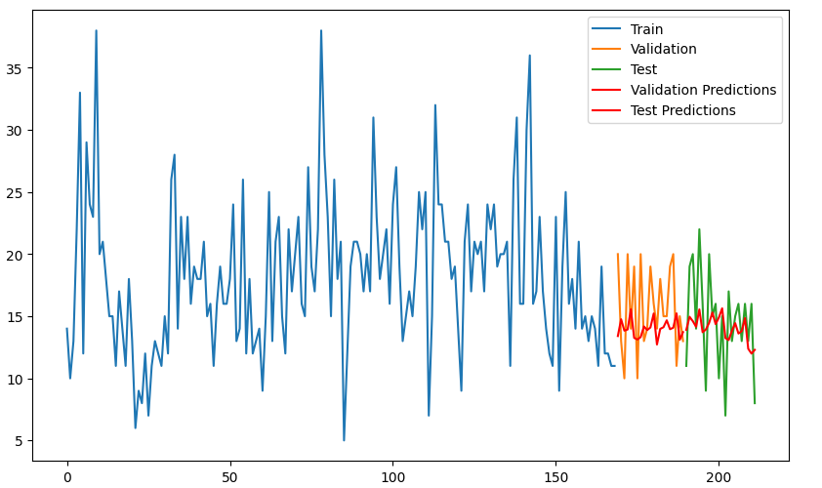
Multi Variate Regression Model
Validation Metrics:
RMSE : 3.87
MAPE : 0.19
R² : -0.36
Adjusted R²: -4.45
Test Metrics:
RMSE : 3.57
MAPE : 0.22
R² : 0.13
Adjusted R²: -2.03

Slide 19
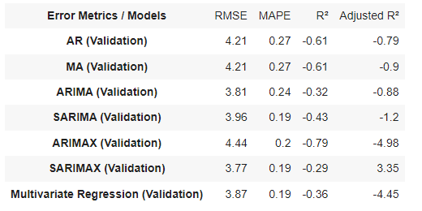
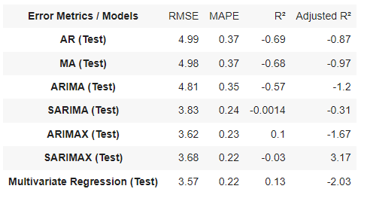
8. Comparison Of All Forecasting Models
For Validation Dataset :
For Test Dataset :
SARIMAX shows the best performance on the validation data, with the lowest RMSE and a positive Adjusted R², indicating it can generalize well during validation.

Slide 20
9. Conclusion
SARIMAX shows the best performance on the validation data, with the lowest RMSE and a positive Adjusted R², indicating it can generalize well during validation.
Multivariate Regression shows the best performance on the test data with the lowest RMSE and highest R2 , indicating good predictive accuracy.
Given these insights, SARIMAX is recommended for its strong validation performance , while Multivariate Regression is also noteworthy for its best performance.

Slide 21


